Slide 1
Introduction to Cloud Computing
Gonzalo De La Torre Parra
Ph.D. Candidate – Electrical Engineering
gonzalo.Delatorre@utsa.edu

Slide 2
Welcome

Slide 3
Who Am I?

Slide 4
Who are You?
How many have hands on experience with Big Data?
How many of you have worked with Python3?
How many of you have worked with Numpy?
How many of you have worked with Pandas?

Slide 5
Before We Begin

Slide 6
Requirements
Personal Computer
Connectivity to Zoom
Access to a Web Browser
Adventure Attitude!!!

Slide 7
Breaks
We will take regular breaks
Please return from breaks on time

Slide 8
Distractions
Please minimize distractions
Email, Chat, Phone, LinkedIn, etc …
Mute your mics unless you need to ask a question

Slide 9
Questions / Feedback
We will have a moment for questions after each covered subsection
Take note of the questions you want to ask
Don’t hesitate to ask questions
Please provide feedback
Always looking to improve!

Slide 10
Any Questions?

Slide 11
Our First Day
Cloud Computing!

Slide 12
Table of Contents
Introduction
Characteristics of Cloud
Types of Clouds
Types of Cloud Providers
Introduction to OpenStack
Big Data Analytics in Jetstream Cloud

Slide 13
Introduction
Cloud computing gradually evolved from mainframe computing which worked on a shared resource model. The definition of Cloud computing according to the National Institute of Standards and Technology is as follows:
“ Cloud Computing is a model for enabling ubiquitous, convenient, on-demand network access to a shared pool of configurable computing resources (e.g., networks, servers, storage, applications and services) that can be rapidly provisioned and released with minimal management effort or service provider interaction “ In simple terms it is storing and accessing data/computing resources over the internet.
Evolution:
• Grid computing: This involved usage of a distributed architecture working on a single problem and the tasks are assigned independent of each other • Utility computing: In the case of utility computing, the resources required for computing are made available for the client as a metered service •SaaS: Software as a service is a network based model that takes care of software licensing and delivery by providing applications through a web browser • Cloud computing: This provides the required computing resources anytime, anywhere for the Clients

Slide 14
Introduction - Architecture

Slide 15
Characteristics
One of the first milestone with cloud computing was with Saleforce.com which delivered enterprise application through a website. Cloud computing brought in a lot of activities that ranged from replacement of on premise infrastructure to on-demand applications. The 5 main characteristics of Cloud Computing: • On- demand self service: Auto provisioning of computer resources as and when needed without any human intervention • Broad Network Access: The computing resources can be accessed anywhere using the Internet • Resource Pooling: Dynamic assignment of resources in order to meet the requirement of the consumers • Rapid Elasticity: The resources are released or assigned as per demand • Measures Service: The clients only pay for the computing resources that were used.
Cloud providers are called as Cloud Service Providers or CSPs. A cloud provider is a service provider that helps with a specific functionality/service. The service provider is chosen depending on your requirement. It depends on the way the computing resources in the cloud are used or accessed.

Slide 16
Characteristics
Virtualization: multiple pseudo servers on one physical device. Having multiple virtual servers instead of a single physical server with segregated data is the backbone of cloud computing.
Democratization of Computing: Democratization has enabled setting up of an infrastructure and application for a particular business in an effortless manner. With cloud computing it provides a centralized access to the common business and web applications that are required for the client. It also allows to massively scale the infrastructure to a level that were not attained previously.
Scalability and fast provisioning: Cloud computing allows businesses to maintain their infrastructure levels as and when required.
Commoditization of infrastructure: Cloud computing allows the IT users to use the resources as and when required allowing them to focus on the important aspects of their roles

Slide 17
Types of Clouds – Cloud System
The Cloud System is based on the Internet - it is an internet based computation. You get to access your data anywhere, anytime using Cloud. Cloud Computing is a service model that consists of shared configurable computing resources that can be accessed according to your requirement through a network. A cloud computing stack consists of: • Software • Platform • Infrastructure
It is massive data processing and it is an easy way to access your programs/ any data, server, databases over the internet or is in sync with other information on the web.
The main types of cloud includes: • Public Cloud • Private Cloud • Community Cloud • Hybrid Cloud

Slide 18
Types of Clouds – Public Cloud
A public cloud can be accessed by any client with access to internet and to cloud space. There is much cost savings with public cloud as there are no upfront costs or infrastructure costs that usually comes up in the case of an on premise set up. The users / clients have increased flexibility with public cloud as it allows capacity to be mapped adjacently with the requirements The public cloud is based on a virtually unlimited capacity whenever the client requires it.

Slide 19
Types of Clouds – Private Cloud
A private cloud is for a particular group or organization and the access rights are given only to this group. Private cloud is either managed by organization itself or by a third party and it exists either on premise or off premise. This diagram shows the 4 approaches to a private cloud. Private cloud helps the organizations on the requirements which reuire a physical or logical separation of data from other organizations. It also provides with ways to improve efficiency on the existing infrastructure that the client uses Private cloud also helps to meet specific technology requirements that their clients might have, It helps reduce risks that are associated with vendor lock-in.

Slide 20
Types of Clouds – Private Cloud
A private cloud is for a particular group or organization and the access rights are given only to this group. Private cloud is either managed by organization itself or by a third party and it exists either on premise or off premise. This diagram shows the 4 approaches to a private cloud. Private cloud helps the organizations on the requirements which reuire a physical or logical separation of data from other organizations. It also provides with ways to improve efficiency on the existing infrastructure that the client uses Private cloud also helps to meet specific technology requirements that their clients might have, It helps reduce risks that are associated with vendor lock-in.

Slide 21
Types of Clouds – Community Cloud
A community cloud is a shared cloud, shared by more than one organization that shares common cloud requirements.

Slide 22
Types of Clouds – Hybrid Cloud
A hybrid cloud is a combined version of at least two clouds where the combination includes public, private and community. Hybrid cloud provides the flexibility to retain a part of the infrastructure while moving the others to cloud. It allows the workloads to be split between the existing infrastructure and the cloud. Hybrid cloud also allows the workloads to be retained between on premise infrastructure or on dedicated infrastructures.

Slide 23
Types of Cloud Providers
There are 3 types of cloud providers:
Software as a Service or SaaS: The SaaS provider provides access to computing resources and applications for the end users. By accessing the cloud, the client gets to access software and other similar applications. SaaS provides the least control over the cloud.
Platform as a Service: PaaS is a service setup. This service provider provides components required for development and operation of applications in a quick and efficient way
Infrastructure as a Service: IaaS has the maximum control over the cloud resources. The complete infrastructure that are required for the organization is out sourced in IaaS, that is the hardware and software like server, storage, network, operating systems.

Slide 24
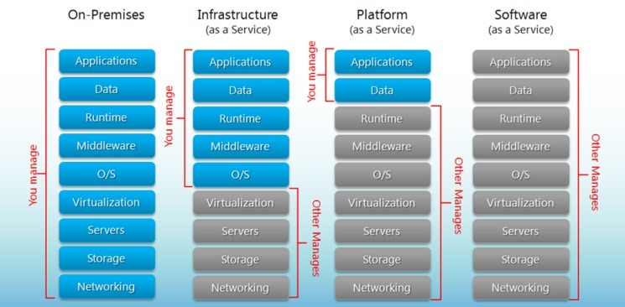
Types of Cloud Providers
Source: https://www.bigcommerce.com/blog/saas-vs-paas-vs-iaas/#the-key-differences-between-on-premise-saas-paas-iaas

Slide 25
Types of Cloud Providers - SaaS
The SaaS or Software as a Service provider provides access to computing resources and applications for the end users. It is a fast growing delivering technology. By accessing the cloud, the client gets to access softwares and other similar applications. SaaS provides the least control over the cloud. Some characteristics of SaaA are: · The users get web access to commercial software · The software is made available to the users using ‘one to many’ mode · software management, upgrades and patches are dealt by the service provider from a centralized location
Applications of Software as a service
It involves an interplay between client-organization and outside world
Those that requires web or mobile access as in mobile sales mgmt. software
Application as a software that is required only for a shorter period of time- for eg: a software that is used and is collaborated for a particular project
Another application could be in a software whose demand shoots up widely; for eg: the tax software whose demand spikes up during a month

Slide 26
Types of Cloud Providers - PaaS
PaaS generally benefits the software development world. It Mixes both simplicity of Software as a Service and power of Infrastructure as a Service PaaS acts as a service setup, providing a platform for creation of softwares, web applications in a quick and an efficient manner. Here the client neednt bother about the buying, maintenance or about the infrastructure that the software requires. This service provider provides components required for development and operation of applications in a quick and efficient way
Characteristics of PaaS includes: · Services offered includes those that are required to fulfill application development process like develop, test, deploy, host, application maintenance · Creation, modification, testing and deploying are done using the user interface creation tools that are accessed through web · Allows concurrent access for multiple users on the same application resource · Integration between web services and databases using common standards · Project planning and communication tools solutions for development team · It also provides with the tools for billing and subscription management
Applications of PaaS
Paas is applied in a scenario which involves accesses for both developers and other parties in a development project It is also used in cases where the testing and deployment services are automated. Some exampes where PaaS is used includes: Google App Engine, Microsoft Azure ServicesForce.com

Slide 27
Types of Cloud Providers - IaaS
Infrastructure as a Service handles on demand - delivery of cloud computing resources. IaaS has the maximum control over the cloud resources Hardwares and Sfotwares infrastructures like servers, network, storage and operating systems that are required for the client are outsourced here. IaaS can be either public infrastructure or private infrastructure or a combuination of both. In a Public Cloud, it consists of shared computing resources deployed on a self-service via web. In a private network, it focuses on virtualisation which is a cloud computing feature on a private network.
Characteristics include: ◦ Computing Resources are considered as a distributed service ◦ Dynamic Scaling is allowed in IaaS ◦ Pricing model used is Utility pricing model which has variable costs ◦ Multiple users have access on the hardware resource

Slide 28
Types of Cloud Providers - IaaS
Applications of IaaS includes :
• Applications which involves significant variations with respect to the demands on the infrastructure that the client requires • For start up organizations that hardly have the capital to investment in the procurement of hardware • IaaS also can be used in scenario where the growth of the organization demands an increase in the hardware resources • When the organization is pressurised to change focus on the limit on capital expenditure to limit operating expenditure
This is a schematic that shows the responsibilities of the cloud service providers (CSP): Lets take a look at some of the common applications of cloud: • Software-as-a-Service (SaaS) Microsoft OfficeLive, DropBox, and CloudNumbers. • Platform-as-a-service (PaaS) Google AppEngine, SalesForce VMforce, and Joyent Accelerator. • Infrastructure-as-a-service (IaaS)Amazon EC2, Eucalyptus Community Cloud, and IBM Cloudburst.

Slide 29
Introduction to OpenStack
OpenStack is : “A cloud operating system that controls large pools of compute, storage, and networking resources throughout a datacenter, all managed through a dashboard that gives administrators control while empowering their users to provision resources through a web interface.”
OpenStack can be considered as a group of software tools for cloud computing platforms. It mainly focuses on the development and management of public and private clouds. Here is a schematic representation of the cloud operating system It helps managing resources that includes: pools of compute resources, storage resources and networking resources to run the applications provisioned to the clients.
OpenStack has a modular architecture that includes components like the following: Nova, Swift, Cinder, Glance, Keystone, Horizon, Neutron, Ceilometer, Heat, Trove, Sahara, Manila

Slide 30
Introduction to OpenStack Architecture

Slide 31
Introduction to OpenStack Architecture
Users
Dashboard
Object Storage
Network Service
Image Service
Compute Service
Block Storage
Identity Service

Slide 32
Introduction to OpenStack
Horizon is the dashboard. It is the only graphical user interface here. Providing accesses and control to manage the cloud.
Nova is the primary component for OpenStack with respect to computations. It takes care of the virtual machines and instances that handles computations by deploying and managing them.
Cinder, the block storage component in openstack
Neutron module takes care of the networking in openstack by making sure that the components get to communicate efficiently and quickly.
Glance: This is openstack’s image service. It takes care of the disk and server images. The services include: - discovery, registration and delivery services for the servier and disk images. It can also be used as templates for the new resources like virtual machines instances that may be allocated.
Swift: acts as a storage for objects and files. This is also called as openstack object storage, which provides a scalable system for storage. Here it provides a unique identifier to locate the objects/files and it the location of storage is decided by OpenStack.
Keystone: is used for the authorization and authentication of openstack services. In short, it is the identity service for openstack. The services that it provides include: Identity, Token, Catalog and Policy services.
Ceilometer & heat are telemetry services and orchestration component of OpenStack respectively. Ceilometer is a data collection service project that transforms and normalises data across core openstack components. Heat allows developers to store the requirements of a cloud application in a file that defines what resources are necessary for that application. In this way, it helps to manage the infrastructure needed for a cloud service to run.

Slide 33
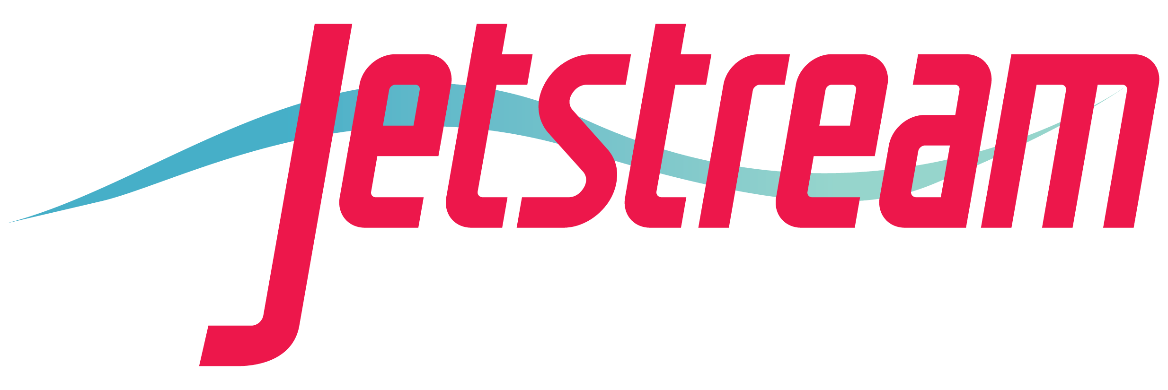
Jetstream: Adding Cloud-based Computing to the National Cyberinfrastructure
funded by the National Science Foundation
Award #ACI-1445604

Slide 34
What is Jetstream?
A resource to expand the community of users who benefit from NSF investment in shared cyberinfrastructure
Production cloud system supporting all domains of science and engineering research sponsored by the NSF
Provide on-demand interactive computing and analysis
Enable configurable environments and architectures
Support computational reproducibility and sharing
Democratizes access to cloud-native technology and software
Focuses on ease of use, but also on maintaining flexiblility

Slide 35
Who do we expect will use Jetstream?
Researchers, developers, and scientists who…
Require somewhere between 4 and a few hundred cores RIGHT NOW and for the foreseeable future, but not forever
Want the ability to fully customize the OS and configuration of their computing setup
Wish to move cloud-native workflows to/from an academic environment
Need interactive mode access to a computing and analysis system

Slide 36
Who do we expect will use Jetstream?
Also…
Science gateway operators using Jetstream as either the frontend or processor for scientific jobs
Anyone who is evaluating or experimenting with software not traditionally supported on XD systems
STEM Educators teaching on a variety of subjects

Slide 37

Diverse research domains
Biology: iPlant and Galaxy VMs, enabling access to and use of new analytical codes in various modalities
Earth Science: VMs capable of requesting NSIDC data and running common routines to enable more effective research and better analyses of data
Field Station Research: VM-based data collection and analysis tools to support data sharing and collaboration
GIS: Deliver the CyberGIS toolkit and provide access to ArcGIS in a VM using IU’s existing site license
Network Science: Build VMs with CIShell tool builders to deliver network analysis tools interactively
Social Sciences: Create VMs that allow selection of data from the Odum Institute in a way that retains provenance and version information

Slide 38
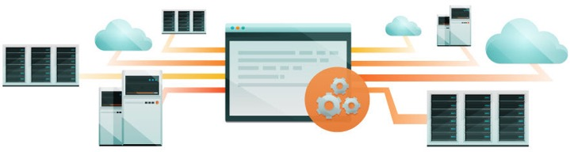
Programmatic Access
Automation, Orchestration, and Workflow
Marathon/MESOS
Docker Machine + Swarm
Apache Airavata
CloudMan & Elasticluster
Web Service APIs
Openstack - Official and unofficial clients + libs (i.e. boto)
EC2* – Integration with AWS-specific code
Atmosphere - Getting language libraries
https://iujetstream.atlassian.net/wiki/spaces/JWT/overview
Configuration Management Tools
Vagrant & Terraform (Hashicorp)
Chef
Notes:
Key distinction: Cloud is someone else’s computer. Cloud computing in this context is some else’s computer that YOU can reconfigure and automate.

Slide 39
How can I use Jetstream?
An XSEDE User Portal (XUP) account is required. They are free! Get one at https://portal.xsede.org
Read the Allocations Overview - https://portal.xsede.org/allocations-overview
Write a successful allocation request – start with a Startup or Education request - https://portal.xsede.org/successful-requests

Slide 40
Where can I get help or learn more?
Wiki: http://wiki.jetstream-cloud.org
User guides: https://portal.xsede.org/user-guides
XSEDE KB: https://portal.xsede.org/knowledge-base
Email: help@xsede.org
Campus Champions: https://www.xsede.org/campus-champions

Slide 41
QUESTIONS?
help@jetstream-cloud.org
Twitter: @jetstream_cloud

